Slide 1















Data Science in Healthcare: Case Studies and Insights
Presented by Sujit Kumar
Date:30/8/24

Slide 2

Introduction to Data Science in Healthcare
Data Science’s Role in Healthcare:
Revolutionizing patient care and treatment.
Improving operational efficiency and reducing costs.
Key Contributions:
Predictive analytics.
Personalized medicine.
Streamlining hospital operations.

Slide 3
Disease Prediction & Diagnosis:-
AI models for early identification of at-risk patients.
01.
Key Areas Where Data Science is Impacting Healthcare
Drug Discovery & Development:-
Accelerating research and development through predictive models.
02.
Data science plays an important role in improving healthcare services and technology. It has widespread applications in the medical field, benefiting patients, practitioners, researchers and those working in administrative positions
Personalized Treatment:-
Tailoring therapies using patient data for better outcomes.
03.

Slide 4
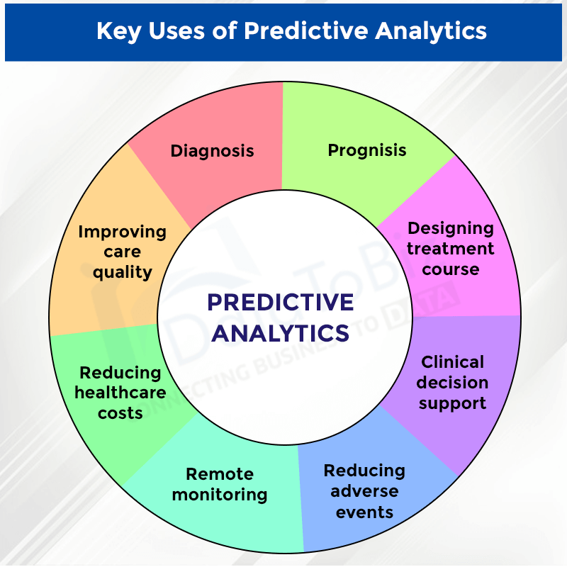
Case Study 1: Predictive Analytics for Disease Prevention
Problem:
High incidence of chronic diseases like heart disease and diabetes.
Solution:
Predictive models analyzing risk factors (age, lifestyle, family history).
Outcome:
Early intervention, reduced hospitalization, and better health outcomes.

Slide 5
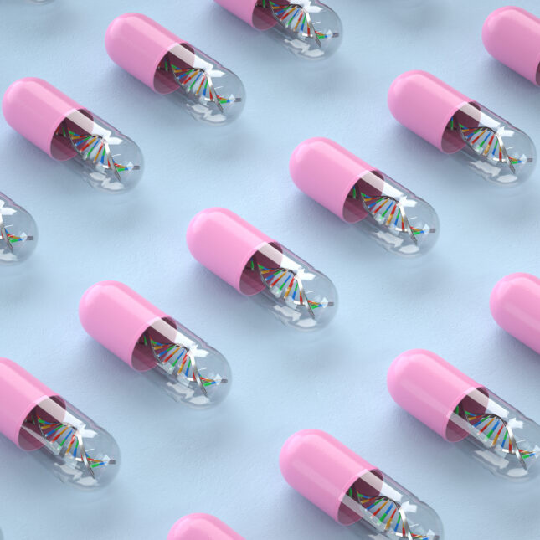
Case Study 2: Personalized Medicine
Problem:
One-size-fits-all treatments are often ineffective.
Solution:
Leveraging genomic data and AI for customized treatment plans.
Outcome:
Increased efficacy, fewer side effects, and improved patient satisfaction.

Slide 6
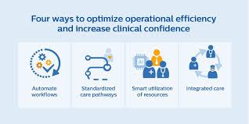
Case Study 3: Operational Efficiency in Hospitals
Problem:
Inefficient resource allocation and poor patient flow.
Solution:
Data-driven decision-making to optimize staffing, scheduling, and resource use.
Outcome:
Cost savings, reduced wait times, and better overall care delivery.

Slide 7

Challenges and Ethical Considerations
Data Privacy:
Ensuring the security and confidentiality of patient data.
Bias in Models:
Potential for AI algorithms to reflect societal biases, leading to unequal care.
Ethical Concerns:
Accountability in AI-driven healthcare decisions.

Slide 8
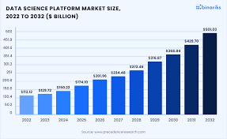
Future Trends in Healthcare Data Science
AI Integration:
Seamless AI incorporation in Electronic Health Records (EHRs) for real-time insights.
Wearable Technology:
Continuous monitoring of health metrics and personalized recommendations.
Blockchain:
Enhancing data security, privacy, and patient trust.

Slide 9
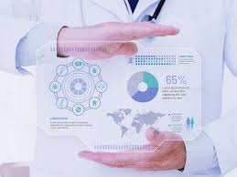
Conclusion
Recap:
Data science is transforming healthcare through predictive analytics, personalized medicine, and operational improvements.
Impact:
Improved patient outcomes, cost savings, and innovation in healthcare delivery.
Future Outlook:
Continuous advancements in data science will lead to better healthcare solutions.

Slide 10
Thank you very much!

